Slide 1

Mentor Introduction PowerPoint Template
Download a copy of this template to work from
Choose an image or images for your slides, matching the sections of your Mentor Introduction Template (see instruction notes on each slide, click here to download)
Feel free to edit as you please! However, please keep the slide with the survey link unchanged
Keep text to a minimum
Don’t forget to delete this slide in your final version!
Under construction icon created by Freepik - Flaticon

Slide 2

Acknowledgement of Country
I begin by acknowledging the Traditional Custodians of the land on which we meet today, and pay my respects to their Elders past and present. I extend that respect to Aboriginal and Torres Strait Islander peoples here today.
In2science celebrates and acknowledges First Nation people as our first scientists.
Notes:
This is optional – if you feel comfortable beginning with this please do so, but if you prefer not to then you can remove this slide. You are also welcome to re-word the Acknowledgement
You may like to look up the name of the Traditional Custodians of the land where your school is located: https://achris.vic.gov.au/weave/wca.html

Slide 3
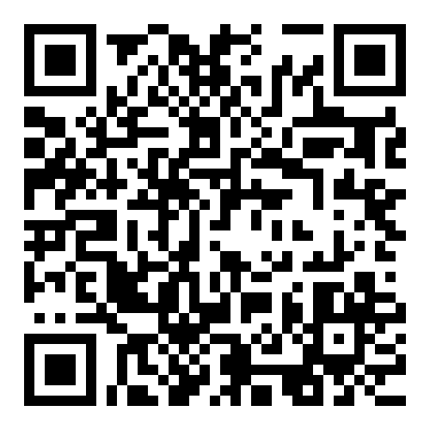
In2science Student Survey
It would be a HUGE help if you could please fill out our quick survey!
Your responses help us to help you 🙂
https://surveymonkey.com/r/student-pre-placement-survey
Notes:
In2science Student Pre-Placement Survey
- Ask the students to complete their online pre-placement surveys (confirm the timing with your teacher).
- Physical copies are available from your In2science Coordinator. Be sure to ask if you need physical copies before your first class!

Slide 4
Can you guess what I do?
Notes:
Getting their attention
- Try starting with an engaging image; something related to your STEM story or course/discipline but isn’t easy to work out straight away!
- For example: a zoomed-in view of a cell (biology) or compound (chemistry), or a place of work (lab, office, workshop, etc.)
- Feel free to use a picture from your actual course/workplace! Just be sure you have photo permissions of anyone else in the photo.

Slide 5
My STEM Story: University
Notes:
My STEM Story: University
- Share a bit about your experience at university. What are your classes like? How different is it from high school?
- Choose an image of your university campus (with you included if possible!)

Slide 6
My STEM Story: Getting Started
Notes:
My STEM Story: Getting Started
- Share a bit about your early experiences with STEM in high school. What was it like for you?
- Choose an image that speaks to your high school STEM experience.

Slide 7
My STEM Story: Looking Ahead
Notes:
My STEM Story: Looking Ahead
- What do you want to do when you grow up? Share a bit about your aspirations after uni!
- Choose one image that speaks to your career journey now or into the future.

Slide 8
Why am I here?
Notes:
Don’t linger on this slide; the answer is on the next one!

Slide 9
Why am I here?
To help YOU on your STEM journey!
Notes:
Why am I here?
- Explain your role in the classroom. You are there to:
- answer questions, about STEM and/or uni
- get to know the students (what are they interested in?)
- provide support (without giving them the answer!)

Slide 10
Thank you!
It would be a HUGE help if you could please fill out our quick survey!
Your responses help us to help you 🙂
https://surveymonkey.com/r/student-pre-placement-survey
Notes:
Thanks
- Thank everyone (students and the teacher) for listening!
- Remind students to finish the survey if they haven’t already.

